Slide 1
CMSC 304
Memory Management
Claire Sparks

Slide 2
Pointers and Dynamic Memory Management
Pointers are used in three ways:
  To create dynamic data structures
  To pass and handle variable parameters passed to functions
  To access information stored in arrays
Why not just use arrays?
  An array’s maximum size must be declared before you use it
  If you do not use all the memory allocated to it, you are wasting memory
  Pointers create dynamic data structures where memory is allocated while the program is running, so you only allocate what you need

Slide 3
Pointers and Dynamic Memory Management
Pointer functions:
  malloc() - Allocates requested size of bytes and returns a pointer first byte of allocated space
  calloc() - Allocates space for an array elements, initializes to zero and then returns a pointer to memory
  free() - Deallocate the previously allocated space
  realloc() - Change the size of previously allocated space

Slide 4
Pointers and Dynamic Memory Management
malloc() reserves a block of memory of a specified size and returns a pointer of type void which can be casted into a pointer of any form
  Syntax:
    ptr = (cast-type*) malloc(byte-size);
  Example:
    int* ptr = (int*) malloc(100 * sizeof(int));
    Allocates either 200 or 400 according to the size of int (2 or 4 bytes)
    Pointer points to the address of the first byte of memory
Notes:
It is unnecessary, as void * is automatically and safely promoted to any other pointer type in this case

Slide 5
Pointers and Dynamic Memory Management
free() explicitly frees the dynamically allocated memory allocated by either calloc() or malloc()
  Syntax:
    free(ptr);

Slide 6
Pointers and Dynamic Memory Management
#include <stdio.h>
#include <stdlib.h>
int main(){
int num, i, *ptr, sum = 0;
printf("Enter number of elements: ");
scanf("%d", &num);
ptr = (int*) malloc(num * sizeof(int)); //memory allocated using malloc
if(ptr == NULL) {
printf("Error! memory not allocated.");
exit(0);
}
printf("Enter elements of array: ");
for(i = 0; i < num; ++i) {
scanf("%d", ptr + i);
sum += *(ptr + i);
}
printf("Sum = %d", sum);
free(ptr);
return 0;
}

Slide 7
Pointers and Dynamic Memory Management
#include <stdio.h>
#include <stdlib.h>
int main(){
int num, i, *ptr, sum = 0;
printf("Enter number of elements: ");
scanf("%d", &num);
ptr = (int*) calloc(num, sizeof(int)); //memory allocated using calloc()
if(ptr == NULL) {
printf("Error! memory not allocated.");
exit(0);
}
printf("Enter elements of array: ");
for(i = 0; i < num; ++i) {
scanf("%d", ptr + i);
sum += *(ptr + i);
}
printf("Sum = %d", sum);
free(ptr);
return 0;
}

Slide 8
Pointers and Dynamic Memory Management
realloc () can change the previously allocated memory size by adding more or less
  Syntax:
    realloc(ptr, newsize);

Slide 9
Pointers and Dynamic Memory Management
#include <stdio.h>
#include <stdlib.h>
int main(){
int *ptr, i , n1, n2;
printf("Enter size of array: ");
scanf("%d", &n1);
ptr = (int*) malloc(n1 * sizeof(int));
printf("Address of previously allocated memory: ");
for(i = 0; i < n1; ++i){
printf("%u\t",ptr + i);
}
printf("\nEnter new size of array: ");
scanf("%d", &n2);
ptr = realloc(ptr, n2);
for(i = 0; i < n2; ++i){
printf("%u\t", ptr + i);
}
return 0;
}

Slide 10
Dynamic Memory Management
Many languages require that heap deallocation be managed automatically
Heap allocation/deallocation and explicit pointer manipulation are inherently unsafe operations
  Can introduce seriously faulty runtime behavior that may even compromise the operating system

Slide 11
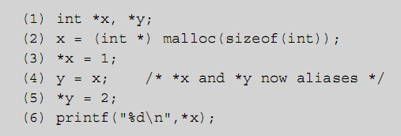
Aliases
Alias: occurs when the same object is bound to two different names at the same time
Can occur during function call, through the use of pointer variables, or through assignment by sharing
Ex:
Notes:
This slide is a lil outta scope but gotta jam it somewhere!

Slide 12
Aliases
Aliases can potentially cause harmful side effects
Side effect: a change in the value of a variable that persists beyond the local scope
Not all side effects are harmful (!!!)
  An assignment statement is intended to cause one
Side effects that change variables whose names do not directly appear in the statement are potentially harmful
  error-prone/difficult to control

Slide 13
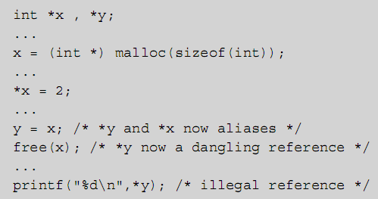
Dangling References
Dangling reference: a memory location that has been deallocated from the environment but can still be accessed by a program
  Occurs when a pointer points to a deallocated object

Slide 14
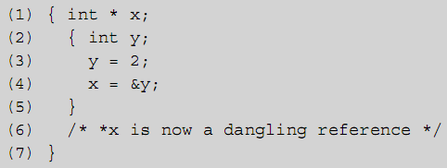
Dangling References
Can also result from automatic deallocation of local variables on exit from a block, with the C address of operator

Slide 15
Dangling References
A program with dangling references may:
  Produce incorrect results
  Corrupt other programs in memory
  Cause runtime errors that are hard to locate
Java does not allow dangling references at all:
  There are no explicit pointers
  There is no address of operator
  There are no memory deallocation operators such as free or delete

Slide 16
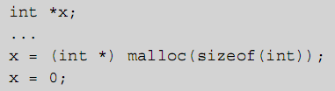
Garbage
Garbage is memory that has been allocated in the environment but that has become inaccessible to the program
Can occur in C by failing to call free before reassigning a pointer variable
A program that is internally correct but produces garbage may run out of memory

Slide 17
Garbage
It is useful to remove the need to deallocate memory explicitly from the programmer
Manual memory management is error prone
Garbage collection: process of automatically reclaiming garbage
  Java uses garbage collection as an alternative to manually managed memory
A garbage collector runs during program execution deallocating unused memory
Various algorithms to determine if a block of memory is unused

Slide 18
Garbage Collection
Garbage collection’s benefits are indisputable
  increased reliability
  decoupling of memory management from class interface design
  less developer time chasing memory management errors
Garbage collection is not without its costs
  Performance impact being the most significant
A garbage requires resources to run, which can slow or halt the program being executed
Although garbage collection increases security and programmer efficiency, it significantly decreases computer efficiency

Slide 19
Automatic Reference Counting
Reference Counting: counts the number of references to each object
  When the reference count drops to zero the object is unreachable and can be deallocated
  Used by Java’s garbage collector
Automatic Reference Counting: determines object references at compile time
  Injects allocation and free statements into the compiled program
Allows for the efficiency of manually managed memory with the security of garbage collection

Slide 20
PokeMart C Code Demo

